Slide 1
Coursera capstone
IBM Applied Data Science Capstone
By: cabinet shah
April 2020

Slide 2
Business Problem
Location of the shopping mall is one of the most important decision that will determine whether the mall will be a success or a failure.
Objectives : To analyse and select the best location in the city of Kuala Lumpur,Malaysia to open a new shoping mall.
This project is timely as the city is currently suffering from oversupply of shopping malls.\
This project is timely as the city is currently suffering from oversupply of shopping malls.
Business question
In the city of Kuala Lampur, Malaysia, if a property developer is looking to open a new shoping mall, where would you recommend that they open it.

Slide 3
Data
Data required
List of neighbourhoods in Kuala Lampur
Latitude and longitude coordinates of the neighbourhoods.
Venue data, particularly data related to shopping malls.
Sources of Data
Wikkipedia page for neighbourhoods
Geocoder package for latitude and longitude coordinates
Foursquare API for venue data

Slide 4
Methodology
Web sceaping Wikipedia page for neighbourhoods list.
Get latitude and longitude coordinates using Geocoder
Use Foursquare API to get venue data
Group data by neighbourhood and taking the mean of the frequency of occurance of each venue category
Filter venue category by shoping mall
Perform clustering on the data by using K-means clustering
Visualize the clusters in a map using folium

Slide 5
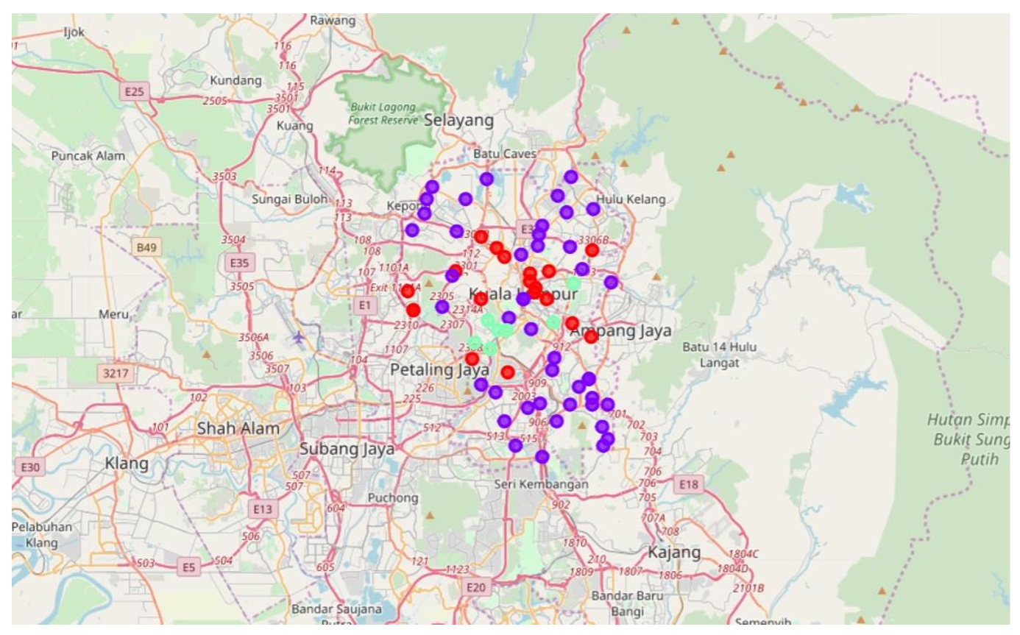
Result
Categorised the neighbourhoods into 3 clusters:
Cluster 0 : Neighbourhoods with moderate number of shoping malls
Cluster 1 : Neighbourhoods with low number to no existence of shopping malls
Cluster 2 : Neighbourhoods with high concentration of shopping malls.

Slide 6
Discusion
Most of the shopping malls are concentrated in the central area of the city.
Highest number in cluster 2 and moderate number in cluster 0
Cluster 1 has very low number to no shopping mall in the neighbourhoods
Oversupply of shopping malls mostly happened in the central area of the city, with the suburb area still have very few shopping malls.

Slide 7
Recomendations
Open new shopping malls in neighbourhoods in cluster 1 with little to no competition
Can also open in neighbourhoods in cluster 0 with moderate competiton if have unique selling propositions to stand out from the competition
Avoid neighbourhoods in cluster 2, already high concentrations of shopping malls and intense competion

Slide 8
Conclusion
Answer to business question: The neighbourhoods in cluster 1 are the most preferred locations to open a new shopping mall
Finding of this project will help the relavant stactholders to capitalize on the opportunities on high potential locations while avoiding overcrowded areas in their decisions to open a new shopping mall.

